Slide 1
Attestation and SPIFFE: Securing Modern Identity and Trust Architecture
Enhancing cloud security through trusted identity frameworks
Notes:
AI-generated content may be incorrect. ---

Slide 2
Agenda Highlights
Understanding Attestation in Security Architecture
Introduction to SPIFFE (Secure Production Identity Framework For Everyone)
Integrating Attestation with SPIFFE
Practical Implementations and Challenges
Notes:
Understanding Attestation in Cloud Security Introduction to SPIFFE (Secure Production Identity Framework For Everyone) Integrating Attestation with SPIFFE Practical Implementations and Challenges

Slide 3
Understanding Attestation in Security architecture
Notes:
Definition and Purpose of Attestation, Types of Attestation: Hardware, Software, and Remote, Role of Attestation in Establishing Trust

Slide 4

Definition and Purpose of Attestation
Security Integrity Verification
Attestation verifies system integrity by ensuring hardware and software configurations meet security standards.
Authenticity Confirmation
It proves the authenticity of a system or component before trust is established in cloud environments.
Foundation for Trust
Attestation acts as a foundational mechanism to establish trust in distributed cloud infrastructures.
Notes:
--- Attestation is a security process used to prove the integrity and authenticity of a system or component before it is trusted in a cloud environment. It verifies that a system’s hardware or software configurations meet predefined security standards and have not been tampered with. Attestation thereby acts as a foundational mechanism to establish trust between entities in distributed and dynamic cloud infrastructures. Image source: AI-generated

Slide 5

Types of Attestation: Hardware, Software, and Remote
Hardware Attestation
Hardware attestation uses TPMs or secure enclaves to cryptographically prove hardware integrity and state.
Software Attestation
Software attestation verifies software integrity using cryptographic hashes or digital signatures.
Remote Attestation
Remote attestation allows systems to prove their integrity status to remote verifiers, aiding cloud security.
Notes:
--- Attestation typically falls into three categories: hardware attestation, which leverages trusted platform modules (TPMs) or secure enclaves to provide cryptographic proof of hardware state; software attestation, which verifies software integrity via cryptographic hashes or signatures; and remote attestation, where a system proves its integrity status to a remote verifier, critical in cloud and distributed environments. Hardware attestation is considered the most robust but may have deployment complexity, while remote attestation enables scaled trust in multi-tenant cloud scenarios. Image source: AI-generated

Slide 6

Role of Attestation in Establishing Trust
Gatekeeper for Trusted Entities
Attestation ensures only verified workloads and devices interact within the cloud ecosystem.
Cryptographic Integrity Verification
Attestation cryptographically verifies entity integrity, reducing risks from misconfigured or compromised components.
Continuous Trust Process
It provides ongoing trust validation essential for zero-trust security architectures.
Dynamic Workload Security
Attestation supports rapid, secure identity validation for ephemeral and dynamic cloud workloads.
Notes:
--- Attestation acts as a gatekeeper, ensuring only trusted workloads and devices can join and interact within a cloud ecosystem. By cryptographically verifying the integrity of entities, attestation reduces the attack surface caused by compromised or misconfigured components. It forms a continuous trust verification process critical in zero-trust architectures and is essential for dynamic, ephemeral cloud workloads that require rapid yet secure identity validation. Image source: AI-generated

Slide 7
Introduction to SPIFFE (Secure Production Identity Framework For Everyone)
Notes:
Overview and Key Principles of SPIFFE, SPIFFE Identity Model: SPIFFE ID and Workloads, How SPIFFE Supports Cloud-Native Environments

Slide 8

Overview and Key Principles of SPIFFE
Secure Workload Identity Issuance
SPIFFE issues secure identities to workloads through a trusted control plane for enhanced security.
Platform Agnosticism
SPIFFE operates independently of platform or environment, supporting heterogeneous cloud/on-prem native setups.
Automated Identity Rotation
SPIFFE automates identity rotation to maintain security without manual intervention.
Unified Authentication and Authorisation
SPIFFE unifies identity management enabling seamless authentication and authorisation across all environments.
Notes:
--- SPIFFE is an open-source framework aimed at providing secure identities to all workloads running in production, irrespective of platform or environment. Key principles include workload identity issuance by a secure control plane, platform agnosticism, and automated identity rotation. SPIFFE abstracts and unifies identity across heterogeneous cloud-native environments, enabling seamless authentication and authorization. Image source: AI-generated

Slide 9

SPIFFE Identity Model: SPIFFE ID and Workloads
SPIFFE ID Structure
SPIFFE ID is a structured URI serving as a cryptographically verifiable identity for individual workloads.
Workload Authentication
SPIFFE IDs enable workloads to authenticate automatically without human intervention, enhancing security.
Dynamic Identity Management
SPIRE implements dynamic issuance and management of SPIFFE IDs for seamless workload identity handling.
Infrastructure Decoupling
The model decouples identity from infrastructure, enabling improved portability and security for workloads.
Notes:
--- The SPIFFE identity model centers around the SPIFFE ID—a structured URI used as a cryptographically verifiable identity for each workload. This identity enables workloads to authenticate without human intervention and provides fine-grained access controls. The framework includes SPIRE, an implementation to issue and manage these identities dynamically for workloads. The model effectively decouples identity from the underlying infrastructure, facilitating portability and security. Image source: AI-generated

Slide 10

How SPIFFE Supports Cloud-Native Environments
Workload-Centric Identity
SPIFFE provides identity based on workloads, not IPs or hostnames, ideal for dynamic cloud environments.
Integration with Kubernetes and Service Mesh
SPIFFE seamlessly integrates with Kubernetes and service meshes to enable secure service-to-service communication.
Enhanced Security with Mutual TLS
Using SPIFFE IDs, mutual TLS provides continuous and automated identity verification for improved security.
Reduced Operational Overhead
SPIFFE automates identity management, reducing manual efforts and enhancing the security posture of cloud deployments.
Notes:
--- SPIFFE supports cloud-native scenarios by providing workload-centric identity independent of IP address or hostnames, which are dynamic in containerized and microservices architectures. It integrates with orchestration platforms like Kubernetes and service meshes, enabling secure service-to-service communication using mutual TLS with SPIFFE IDs. This reduces operational overhead and enhances security posture by offering continuous, automated identity verification. Image source: AI-generated

Slide 11
Integrating Attestation with SPIFFE
Notes:
Workflow of Combining Attestation and SPIFFE, Benefits of Integrating Attestation with Workload Identity, Common Use Cases and Scenarios

Slide 12
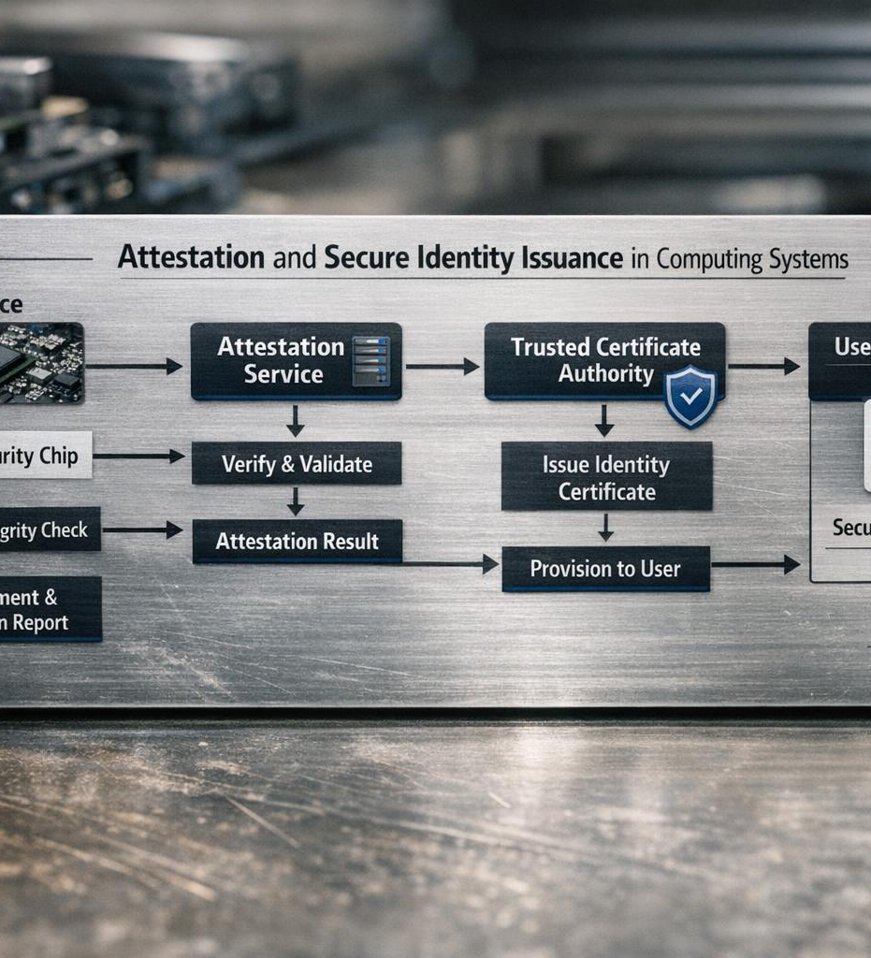
Workflow of Combining Attestation and SPIFFE
Attestation Process
Workloads undergo attestation to verify authenticity and ensure system integrity before receiving identities.
SPIFFE ID Issuance
Successful attestation triggers issuance of SPIFFE ID, linking trustworthiness to workload identity.
Secure Workload Interaction
Only attested workloads receive identities, enabling secure interactions within dynamic systems.
Notes:
--- Integrating attestation with SPIFFE involves a workflow where a workload first undergoes attestation to verify its authenticity and system integrity. Successful attestation triggers the issuance of a SPIFFE ID, binding the verified trustworthiness to the workload's identity. This integration ensures that only attested, trusted workloads receive identities to interact securely within a system, automating trust establishment in dynamic environments. Image source: AI-generated

Slide 13

Benefits of Integrating Attestation with Workload Identity
Enhanced Trust and Security
Integrating attestation with workload identity provides cryptographically verifiable trust to cloud systems, ensuring secure identity binding.
Mitigation of Identity Spoofing
This integration reduces risks of identity spoofing and unauthorized access by validating system states before identity issuance.
Support for Zero-Trust Models
Strengthens zero-trust security by continuously verifying identities and system trustworthiness within cloud ecosystems.
Automation and Compliance
Reduces human error through automation and provides auditable proof-of-trust for compliance with hardware and software integrity.
Notes:
--- Combining attestation with workload identity issuance brings robust, cryptographically verifiable trust to cloud ecosystems. It mitigates risks of identity spoofing and unauthorized access by ensuring identities are bound to trustworthy system states. This integration strengthens zero-trust security models, reduces human error through automation, and enhances compliance by providing auditable proof-of-trust anchored in hardware and software integrity. Image source: AI-generated

Slide 14

Common Use Cases and Scenarios
Service Mesh Security
Attested workloads receive SPIFFE IDs enabling encrypted and trusted service-to-service communication in service meshes.
Multi-Cloud Interoperability
Workload identities remain interoperable and trusted across multiple cloud providers ensuring seamless security.
IoT Device Attestation
Device attestation links IoT devices to workload identities, preventing compromised devices from network access.
Notes:
--- Common scenarios include securing service meshes where only attested workloads receive SPIFFE IDs for encrypted service-to-service calls, multi-cloud environments ensuring workload identities are interoperable and trusted across providers, and IoT deployments where device attestation maps to workload identities to prevent compromised devices from accessing networks. These use cases highlight how attestation+SPIFFE work together to secure identities at scale. Image source: AI-generated

Slide 15
Practical Implementations and Challenges
Notes:
Deployment Considerations and Best Practices, Security Challenges and Mitigation Strategies, Future Trends in Attestation and SPIFFE

Slide 16

Deployment Considerations and Best Practices
Infrastructure Integration
Attestation and SPIFFE deployment must seamlessly integrate with existing infrastructure and security policies.
Automate Identity Management
Use SPIRE to automate identity lifecycle management for efficient and secure operations.
Hardware-Based Root of Trust
Leverage hardware attestation capabilities to establish a strong root of trust for security.
Continuous Attestation and Monitoring
Implement continuous attestation with monitoring and logging to enhance operational visibility.
Notes:
--- Effective deployment of attestation and SPIFFE requires careful integration with existing infrastructure, consideration of hardware attestation capabilities, and alignment with organizational security policies. Best practices include automating identity lifecycle management with SPIRE, leveraging hardware-based root of trust, and implementing continuous attestation to accommodate dynamic cloud workloads. Additionally, monitoring and logging attestation events improve operational visibility. Image source: AI-generated

Slide 17

Security Challenges and Mitigation Strategies
Attestation Spoofing Risks
Potential spoofing attacks threaten the integrity of identity attestation processes in security systems.
Mitigation with Cryptography
Strong cryptographic primitives and multi-factor attestation enhance security against spoofing and misconfiguration.
Regular Auditing Practices
Continuous auditing of attestation and SPIFFE systems ensures early detection and response to security issues.
Integration with Security Frameworks
Tight integration with broader security frameworks reduces risks and supports fallback mechanisms for failures.
Notes:
--- Challenges include potential attestation spoofing attacks, complexities in managing diverse hardware attestation capabilities, and risks posed by misconfigured identity issuance processes. Mitigation strategies involve using strong cryptographic primitives, multi-factor attestation combining hardware and software signals, regular auditing of attestation and SPIFFE systems, and fallback mechanisms to handle failures gracefully. Ensuring tight integration with broader security frameworks further reduces risks. Image source: AI-generated

Slide 18

Future Trends in Attestation and SPIFFE
Integration with Confidential Computing
Future attestation will integrate confidential computing to enhance data privacy and security during processing.
Decentralized Identity Models
Support for decentralized identity models will empower more secure and flexible identity verification methods.
AI-driven Anomaly Detection
AI will enhance attestation by detecting anomalies and improving trustworthiness of authentication results.
Zero-Trust and Multi-Cloud Adoption
Zero-trust architectures and multi-cloud strategies will drive innovation in scalable, automated trust frameworks.
Notes:
--- Looking ahead, attestation and SPIFFE are expected to evolve with advancements such as integration with confidential computing, support for decentralized identity models, and increased AI-driven anomaly detection in attestation results. The growing adoption of zero-trust architectures and multi-cloud strategies will further drive innovation in scalable, automated trust frameworks. SPIFFE standards may also expand to encompass broader identity claims beyond workload authentication. Image source: AI-generated

Slide 19
Conclusion: Enhancing Cloud Security through Attestation and SPIFFE Integration
Role of Attestation
Attestation verifies hardware and software integrity to establish trust in cloud environments.
SPIFFE Framework
SPIFFE offers a robust identity framework for workloads in cloud-native systems.
Integration Benefits
Combining attestation with SPIFFE enhances security through reliable identity verification and trust.
Future Security Advancements
Adopting best practices and overcoming challenges will drive future cloud security improvements.
Notes:
In summary, attestation plays a critical role in establishing trust within cloud environments by verifying hardware and software integrity. SPIFFE provides a robust framework for workload identity in cloud-native contexts. Integrating attestation with SPIFFE strengthens security, enabling reliable identity verification and seamless trust establishment. Embracing best practices and addressing challenges will pave the way for future advancements in cloud security.

